Slide 1
AWS V/S Azure
Presented by Mahesh Kumawat (Sr. Project Manager) Accenture

Slide 2
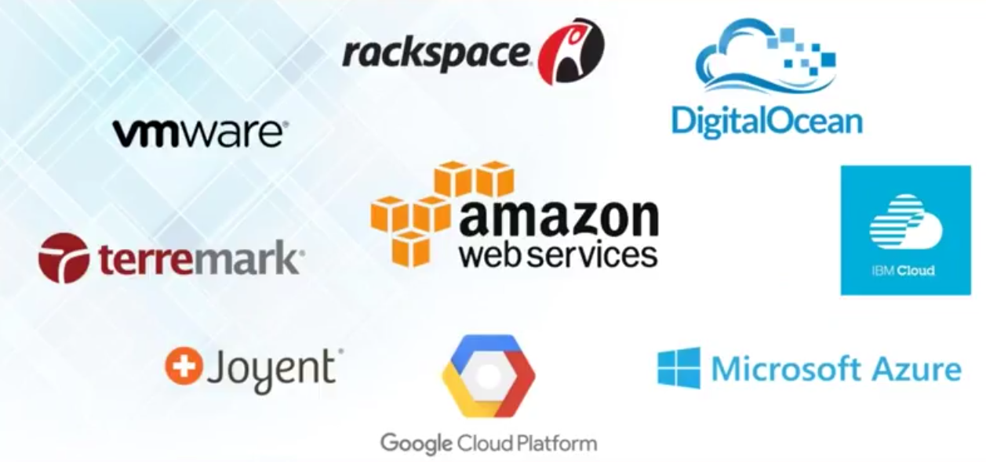
Cloud Players

Slide 3
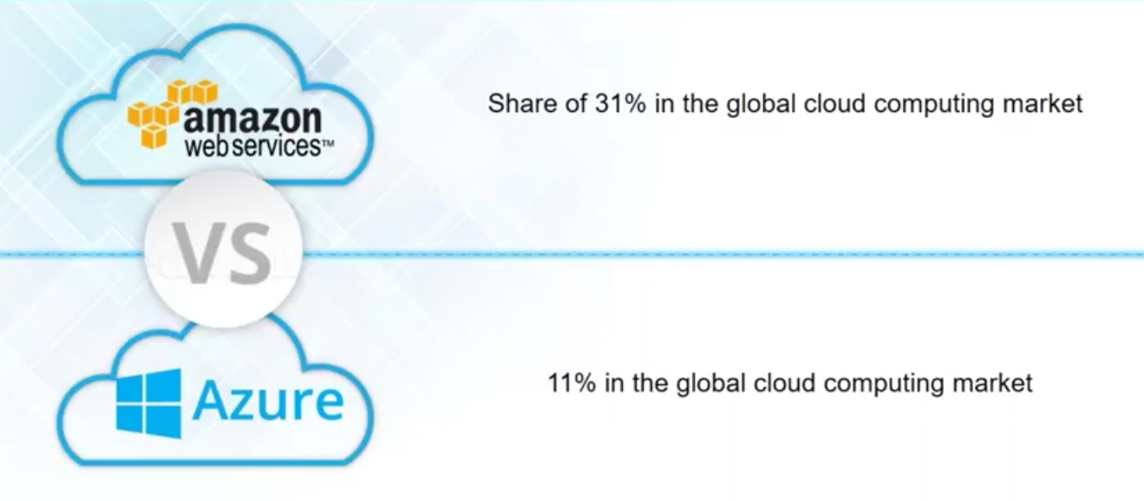
AWS vs Azure

Slide 4
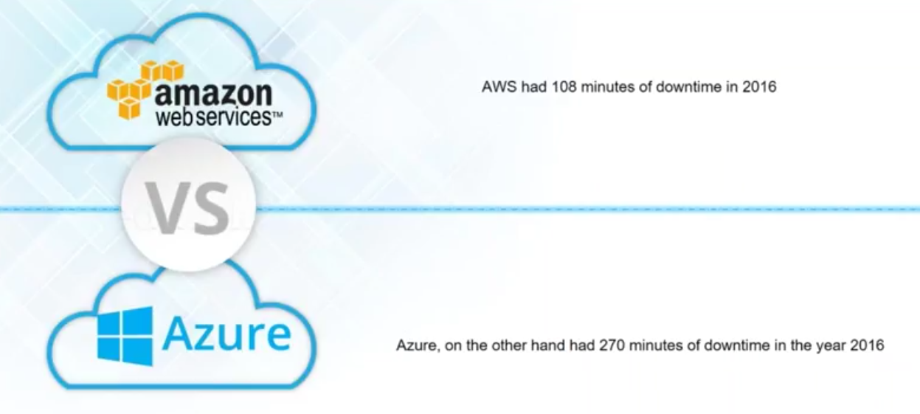
Uptime

Slide 5
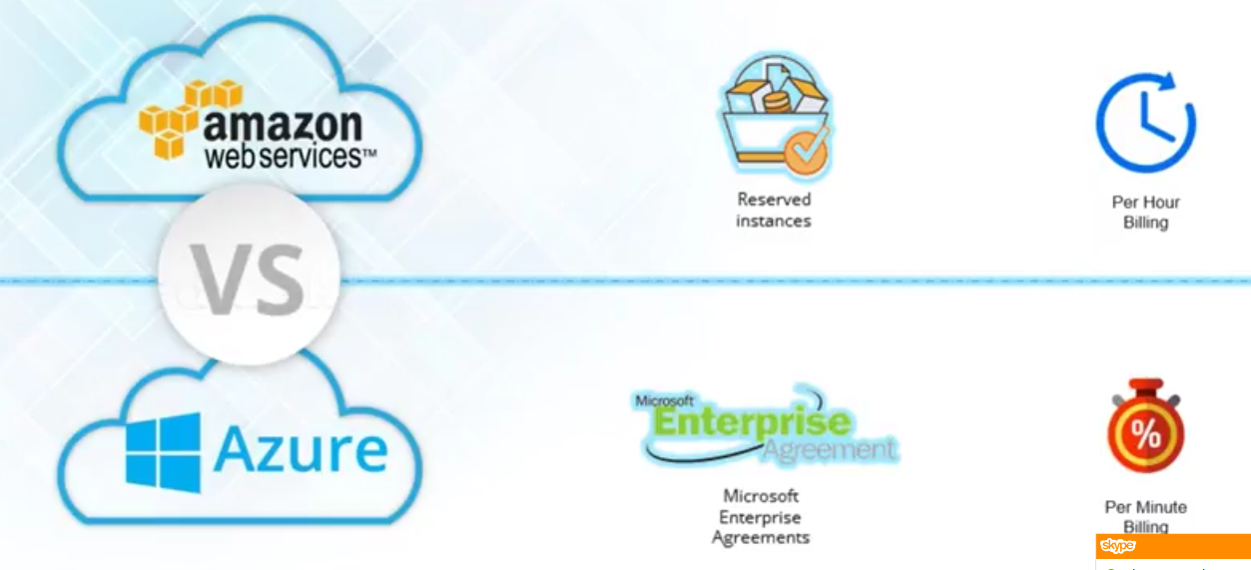
Pricing

Slide 6
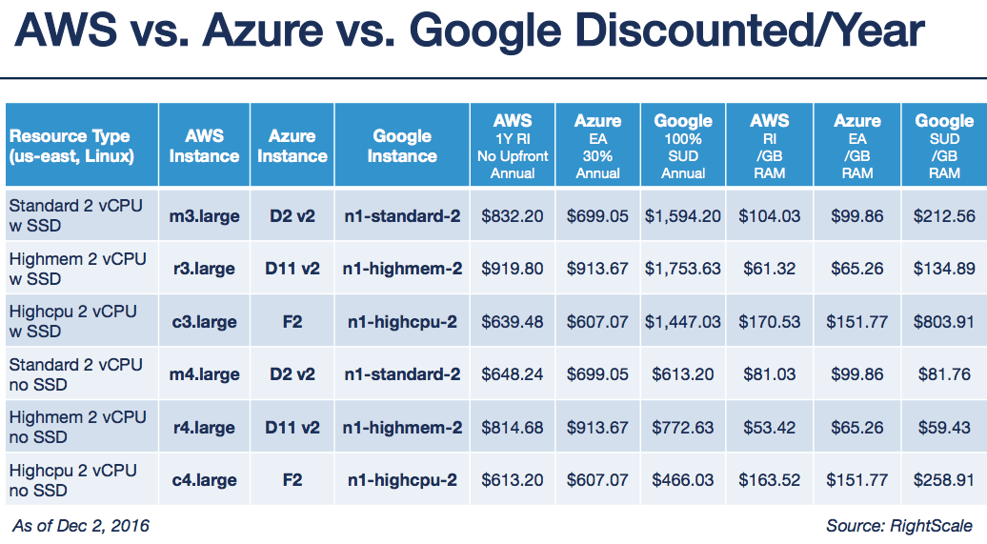
Compute Details

Slide 7
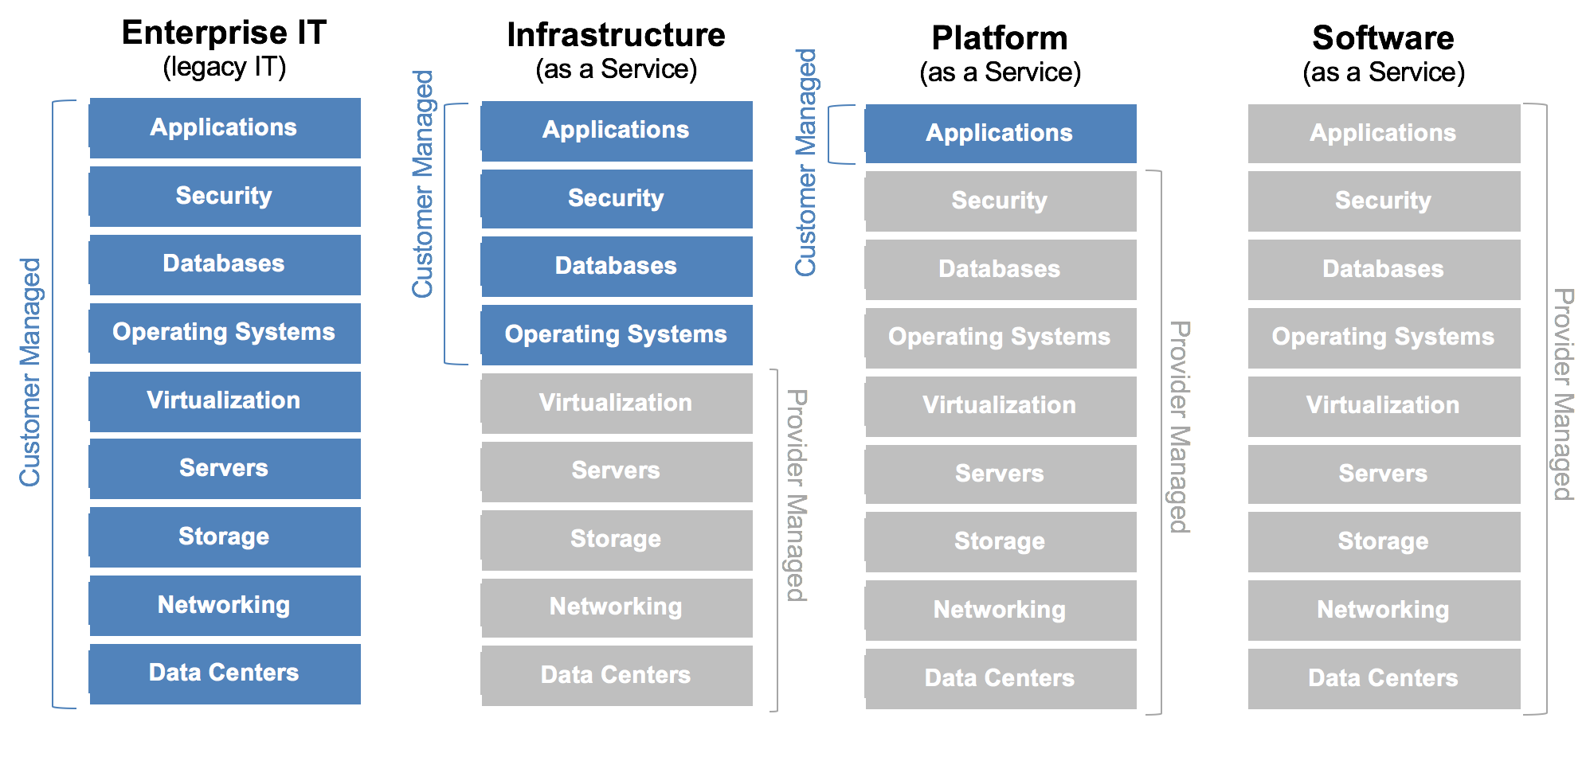
Cloud Technology

Slide 8
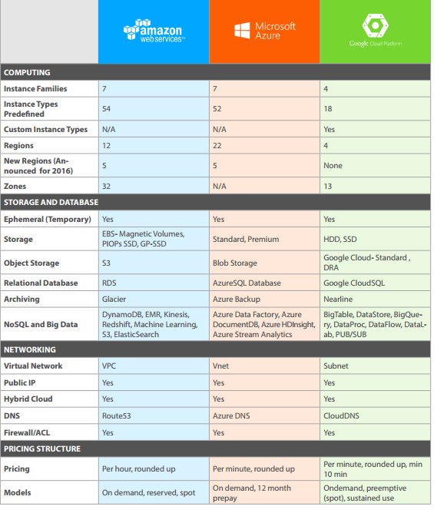
AWS vs Azure vs Google Cloud

Slide 9
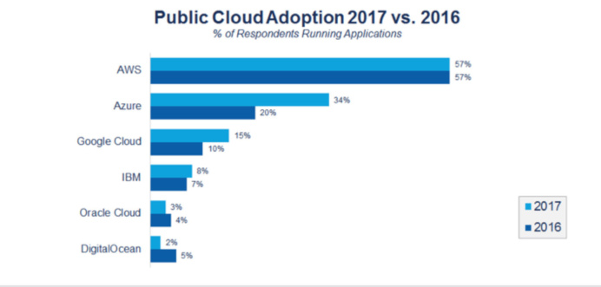
Cloud Comparision

Slide 10
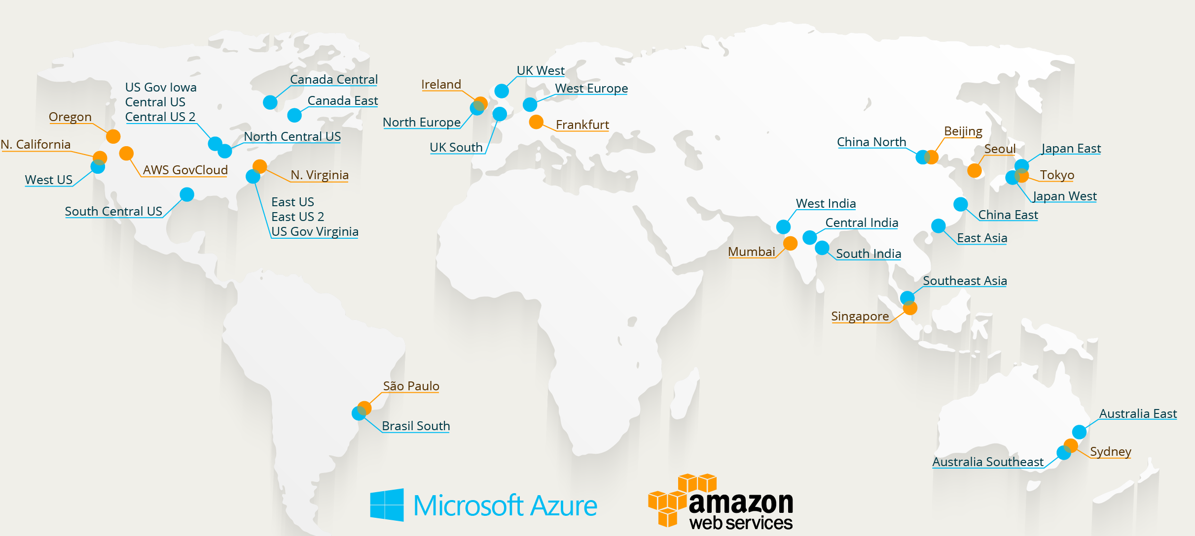
Data Centres

Slide 11
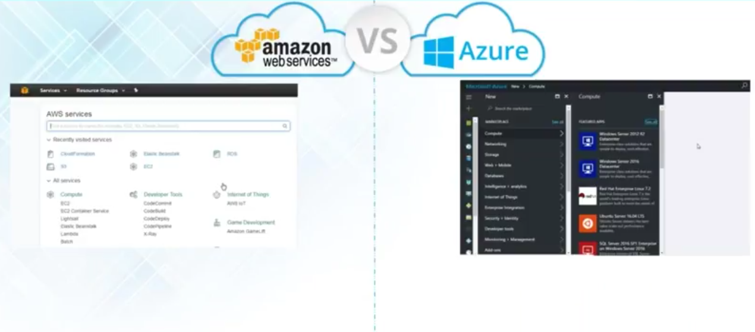
User Interface

Slide 12
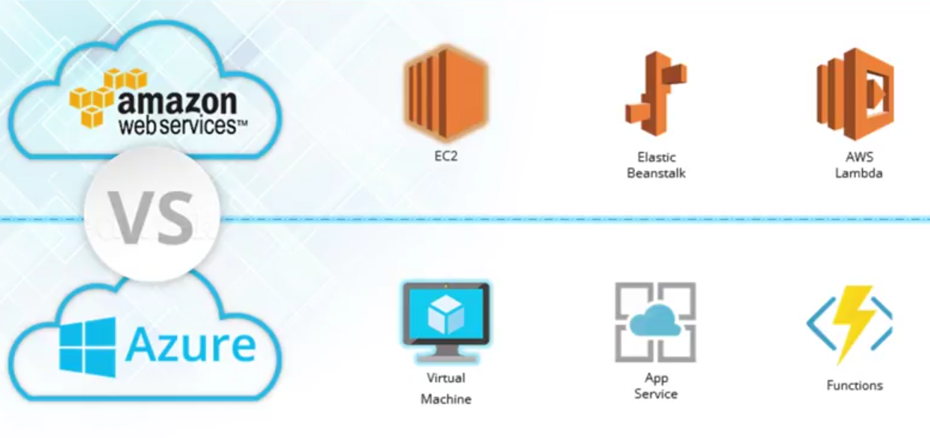
Compute

Slide 13
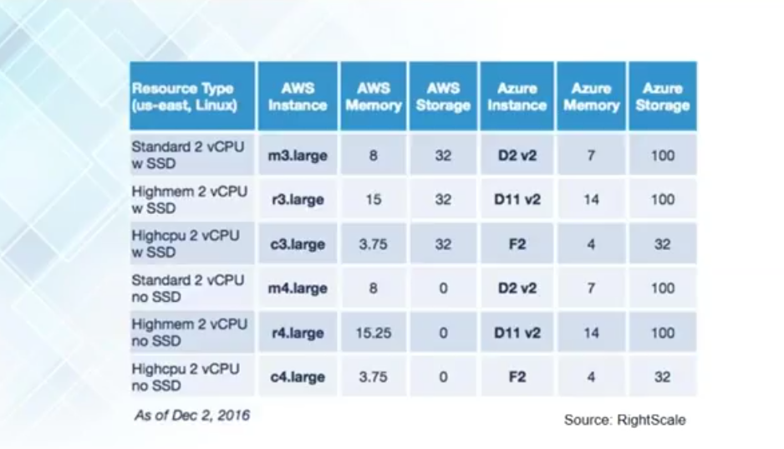
Compute

Slide 14
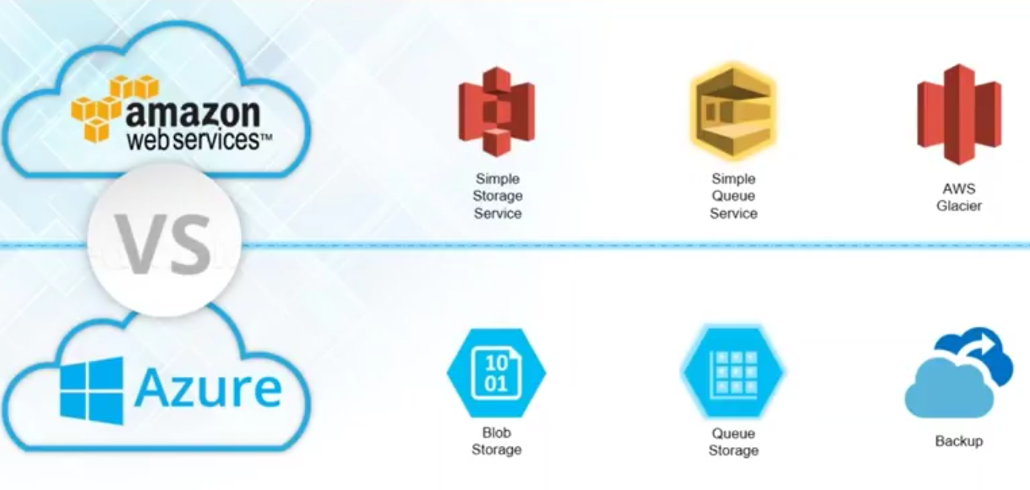
Storage

Slide 15
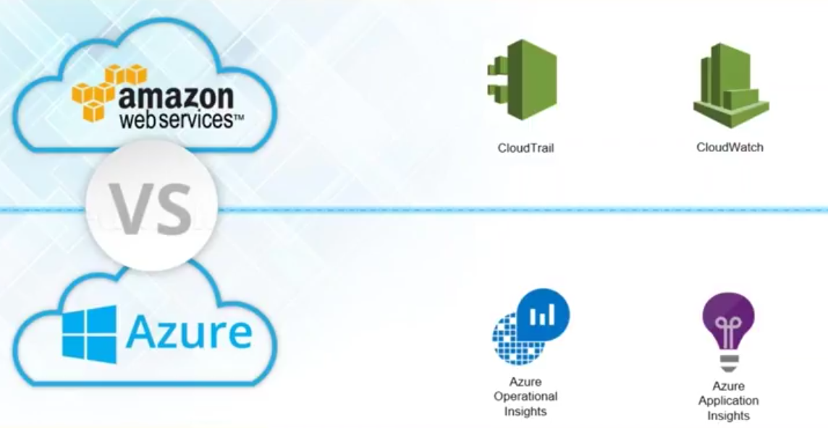
Troubleshooting and Monitoring

Slide 16
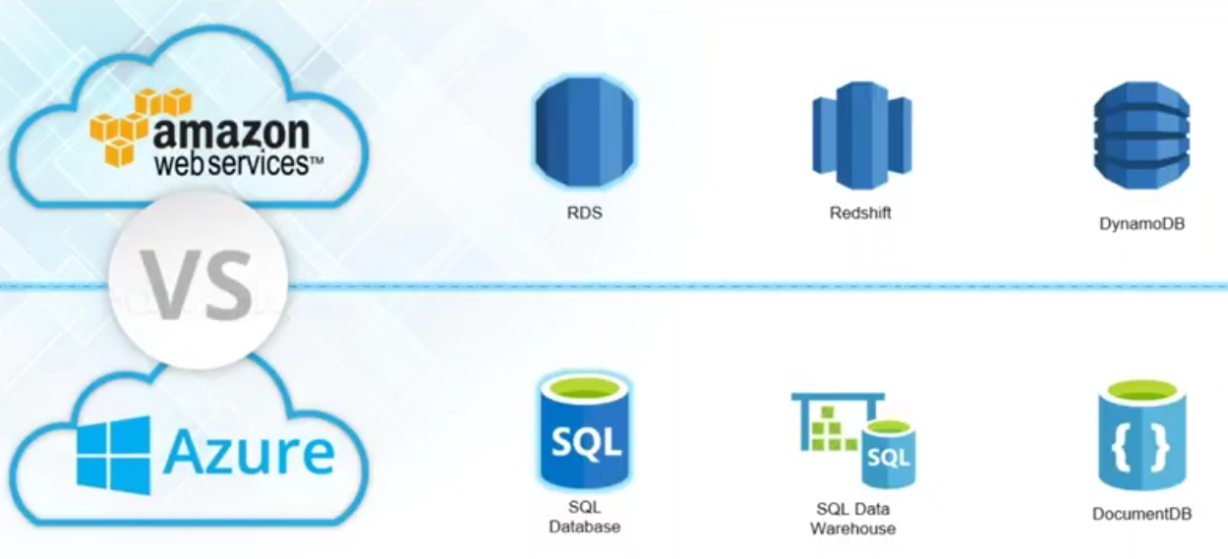
Databases

Slide 17
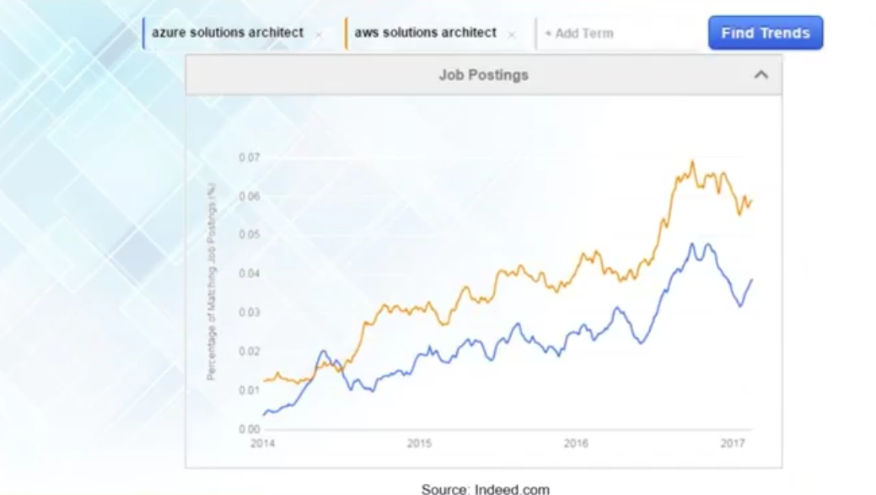
Job Trends

