Slide 1
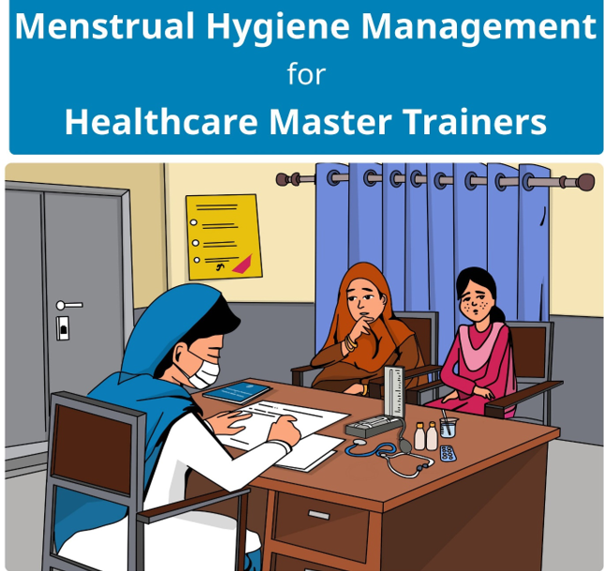
Training of Trainer on Menstrual hygiene management (Mhm)
Workshop Introduction
An Overview (Building Concepts)

Slide 2
Objective of the session
By the end of this session participant will have knowledge:
About the training of doctors as master trainers and other healthcare providers as front-line workers.
The Master Trainers will train Community Health Workers (CHW)/ Lady Health Workers (LHWs) to efficiently inculcate MHM messages to women and girls in the communities and institutions.
Support improving MHM practices addressing taboos and social exclusion thereby promoting gender equality.
Notes:
Proposal:
Unintended pregnancies and the complications that arise from unsafe abortions are tragically common experiences for millions of women and girls in Pakistan. With approximately 34% of currently married women in Pakistan using modern contraceptive methods (and 21.6% for all women) (Track20 2017), the rate of unintended pregnancies is high, and many women facing unintended pregnancies resort to unsafe abortion (Naveed, Shaikh, and Nawaz 2016). In 2016, the use of modern methods of contraception is estimated to have averted 2,638,000 unintended pregnancies and 805,000 unsafe abortions (Track20 2017). Abortion is highly stigmatized and safe abortion and postabortion care (PAC) services are often inaccessible. Since 2007, Ipas has worked closely with government and NGO partners to support clinical trainings in woman-centered PAC, sustainability of safe reproductive health technologies, and strengthening of national partnerships in support of women’s sexual and reproductive health and rights. Through these efforts, we work to ensure the integration of postabortion contraception.
FR Protocol:
While data do not exist on the actual usage of misoprostol for MA in facilities or outside of facilities, trends in Pakistan between 2002 and 2012 show increased rates of induced abortion at the same time as minimal increases in contraceptive prevalence and increases in the proportion of postabortion complications that are less severe. These trends suggest that 1) women are increasingly relying on induced abortion to deal with unintended pregnancies, and 2) women are resorting to safer methods, like misoprostol, for clandestine abortions, rather than unsafe methods [7]. Despite greater safety of misoprostol versus other methods of clandestine abortions, the rate of complications over this same time period has increased, suggesting also that women and girls who may be using misoprostol need complete and accurate information on dosage and use to avoid complications. Furthermore, in a 2012 survey, health providers perceived misoprostol as among the top two most commonly used abortion methods [7].

Slide 3
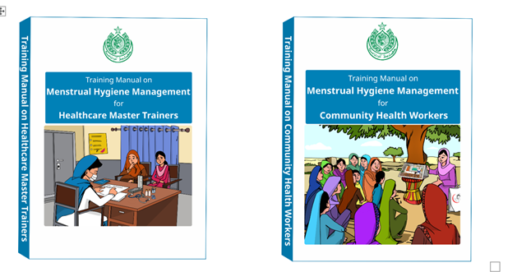
What is training Material
Training Manual on MHM for Master Trainers (Doctors)
Training Manual on MHM for Community Health Workers are for the doctors to educate/ train and guide the healthcare facilities doctors and Community Health Workers.
To share MHM messages with the women, mothers and adolescent girls who visit health facilities for health and hygiene related consultations.
The community women and girls through specific orientation sessions at the community level

Slide 4
Details of TOT on MHM
The Training of Trainer (ToT) programme has been designed for doctors, can be developed as Master Trainers (MTs), and they can then train other doctors, as well as Community Health Workers (CHWs).
Training details:
The Master Trainer ToT is designed, as a 3-day training.
The core material to be used for the training of Master Trainers
    Section-1 of the Training Manual on MHM for Healthcare Master Trainers.
    Section-2 of the Manual contains the session plans and handouts that will be used by the doctors to counsel patients.
Manual for Community Healthcare Workers on Menstrual Hygiene Management will be used by the CHWs to train women and girls at community level.
Notes:
3.5 year project
During the formative phase, we will complete a desk review and conduct mixed methods qualitative research, using key informant interviews, focus groups, individual and small group interviews, and participant observation to explore the specific pathways and options for post-MA contraceptive decision-making for women and adolescent girls in Kenya and Pakistan.
During implementation, Ipas and DKT (along with other implementation partners, to be determined) will work in consultation with local authorities and stakeholders to implement the most promising interventions in Kenya’s Nakuru district and Pakistan’s Punjab province, with opportunities to refine interventions based on continued user input. Ipas’s evaluation partner, the Population Council, will conduct a cluster-randomized trial to compare women’s and adolescent girls’ (ages 15 - 19) contraceptive uptake (measured at two weeks and four weeks after MA) and one-year contraceptive continuation rates (including timely method-switching) after self-use of MA between intervention and nonintervention geographic clusters. We also plan to collect data on three-month and six-month contraceptive continuation.
Ipas, in conjunction with partners and other key stakeholders, will develop and implement strategies for sustainable scale-up of successful interventions. In the final months of the investment, we will carry out a communications and dissemination strategy to share findings and evidence for interventions to improve post-MA contraceptive uptake and continuation.

Slide 5

Getting to know each other(Introduction)
Menstrual Hygiene Management in healthcare facilities.
I AM ONLY ONE,
BUT STILL, I AM ONE,
I CANNOT DO EVERYTHING
BUT I CAN DO SOMETHING
AND BECAUSE I CANNOT DO EVERYTHING
I WILL NOT REFUSE TO DO
THE SOMETHING I CAN DO
Notes:
In the formative research, we will assess the contraceptive experiences, needs, and preferences of women and adolescent girls who have pursued self-use of MA drugs, with regard to contraception and the prevention of future unintended pregnancies. We will also investigate the contraceptive knowledge, delivery, and/or referral needs and practices of pharmacists/medicine sellers who provide MA drugs (in this document, “medicine sellers” is a general term that may include licensed or unlicensed medicine sellers, and others involved in the provision of MA drugs and/or contraceptives, depending on the cultural context). Likewise, we will examine the influences, biases, and misconceptions of public and private sector contraceptive providers, particularly for methods that can only be accessed in a clinical setting, such as intrauterine devices. The investigation will include interviews with influential intermediaries—such as women’s groups, social media outlets, and hotlines—to learn about their spheres of influence and whether—and if so how—they might be involved in our interventions. The research will lead to the design, development, and iterative testing of multiple intervention prototypes.

Slide 6
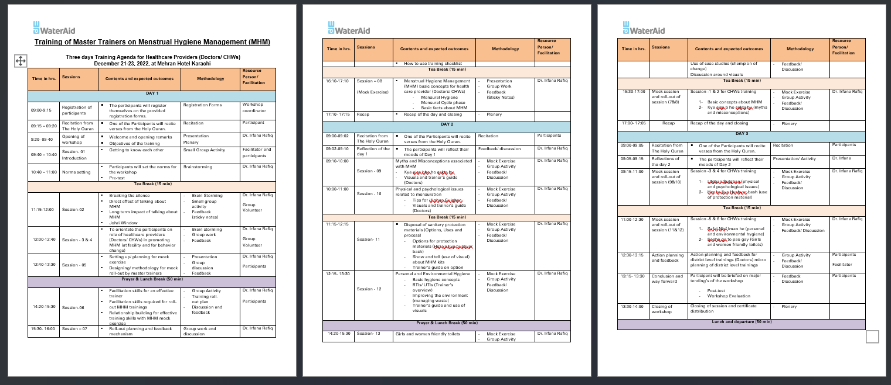
Agenda of the TOT

Slide 7

Breaking the Ice
Menstrual Hygiene Management has a direct effect on women’s and girls’ wellbeing during menstruation.
Direct effect/benefits of talking about Menstrual Hygiene Management (MHM) | longer-term impact of talking about Menstrual Hygiene Management
Uphold good menstrual practices Manage regular symptoms Identify problems Confidence Not feeling ashamed Participate | Better reproductive health Overall health and wellbeing Confidence Building Economic growth Gender equality Fulfil their rights

Slide 8
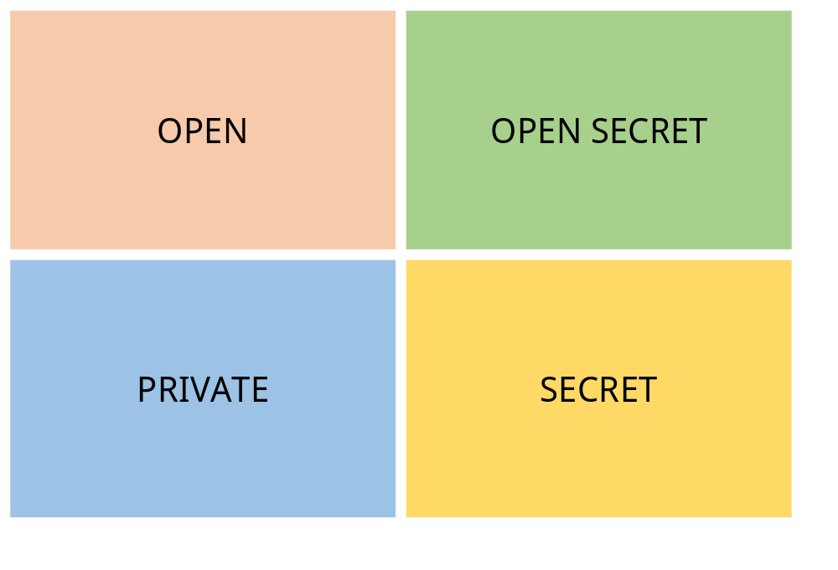
Breaking the Ice- Johri Window
Group Activity:
Open: Something you would easily talk about in public, with anyone. Example: The sun is shining today
Private: Something you would talk about confidentially with specific people. Example: My health issue
Open secret: Something people know about but do not talk about. Example: Corruption
Secret: Something people do not share or talk about with anyone.

Slide 9

Role of Healthcare Professionals – Doctors
Activity: What can you do as a Healthcare Worker – Doctor?
Q-1. What role can a doctor play in promoting Menstrual Hygiene Management at health facilities?
Q-2. How they can be involved in bringing about behaviour change regarding Menstrual Hygiene Management?
Train other healthcare workers and health facility staff on Menstrual Hygiene Management

Slide 10
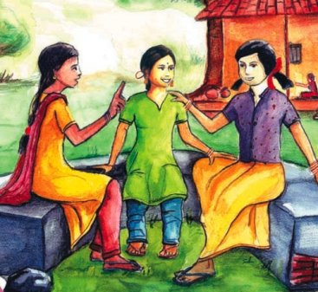
Role of Community Health Workers
What can you do as a Community Health Worker?
What are some key messages that a CHW can give to women and girls at community level so that they can improve their Menstrual Health/hygiene?
How they can be involved in bringing about behaviour change regarding Menstrual Hygiene Management?
CHWs have continuous interactions with the community and can therefore provide constant feedback and guidance.

Slide 11
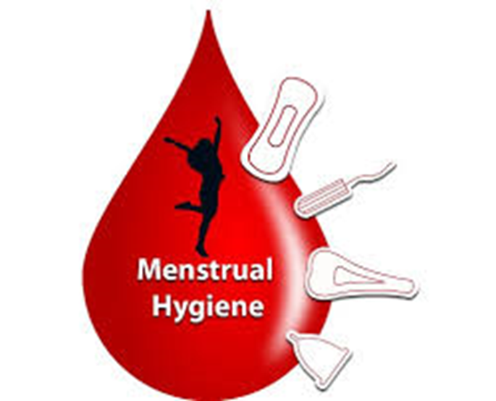
Menstrual Hygiene Management -Basic Concepts
Menstrual Hygiene Management for Master Trainers (MT) comprises of Six basic topics/ concepts.
What is menstrual hygiene
Myths, fears, and misconceptions
Physical and emotional changes that women and girls experience pre and during menstruation
How to manage menses, options for sanitary material, use and proper disposal of used sanitary material
How to maintain appropriate hygiene
How to create appropriate toilet facilities for maximum safety and privacy

Slide 12
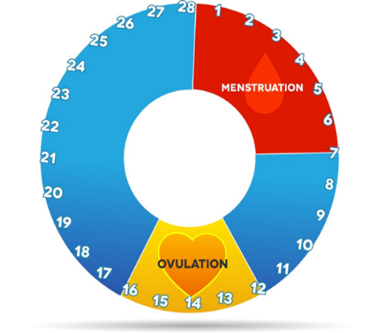
Menstrual Cycle Phases
You should keep a track of your menstrual cycle. In this way, you will know when you will start menstruating and you can prepare for it. It also helps to understand what is normal for you. You can do this by marking a calendar, using a bracelet or an app on your phone. When tracking, the first day of your menstruation marks the first day of your cycle.
Notes:
Bar at bottom – year one goes to milestone check-in
UCD and Intervention design should overlap or be completely separate

Slide 13
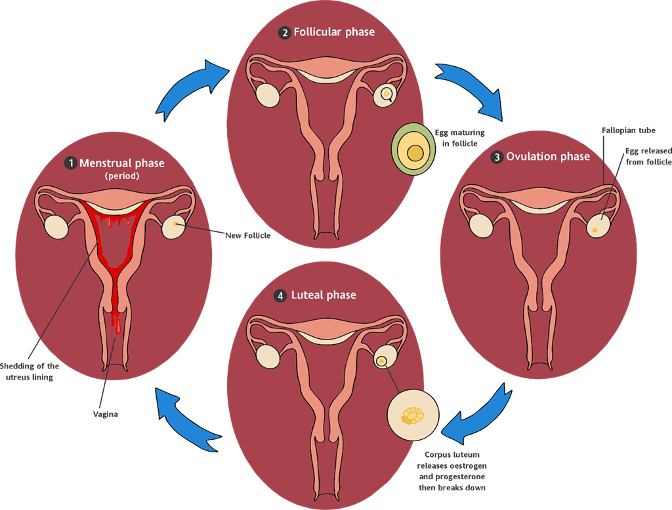
Menstrual Cycle Phases

Slide 14
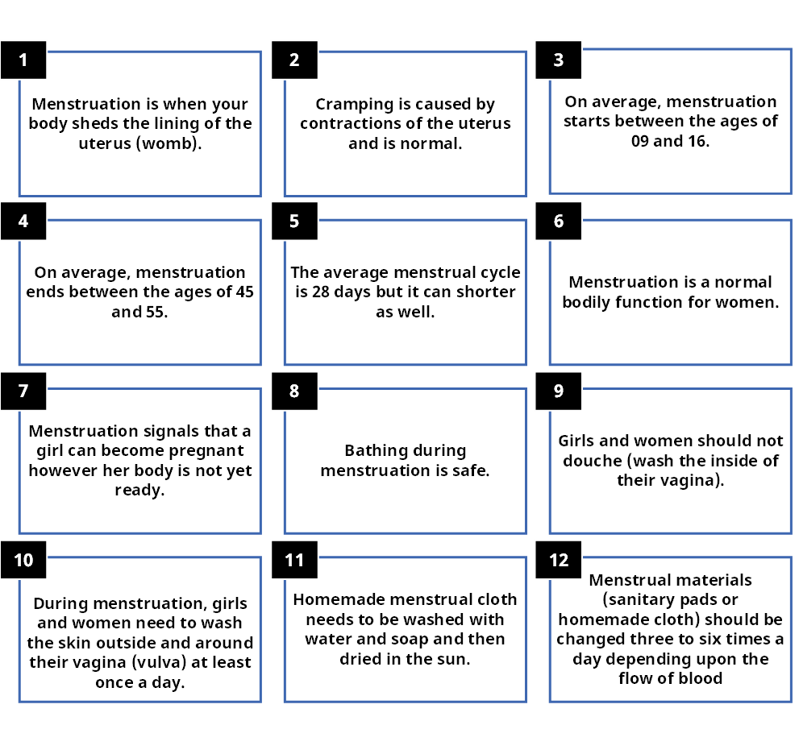
Basics Facts About Menstrual Hygiene Management

Slide 15
Myths and Misconceptions
Some of the more common myths and misconceptions are as under:
A woman or girl cannot take a bath when she has her menses.
It is said that a menstruating woman is impure, sick or even cursed.
Those with menses are unclean and therefore they cannot pray, recite the Quran, or fast.
Once a girl starts her menstruation, it means that she is ready for marriage.
Menstruating women and girls should not eat certain foods (e.g., yoghurt, meat, vegetables, eggs, cold water, sour food, fruits, cold drinks).
Menstruating girls and women should not play sports or be active. When you come across a new fear or myth, add it to this session in the manual. Make sure that the patients properly understand the explanations for each question/myths.

Slide 16

Options, Uses and Disposal of Sanitary Protection Material
Some of important option for protection material is as under
One time use cloth pad/napkin
Reusable cloth napkin
Disposable sanitary pads (thin and thick)
Cotton (rui) wrapped in gauze
Cotton (rui) wrapped in cloth
Nothing

Slide 17
Personal and Environmental Hygiene
Some basic guidance for maintaining personal hygiene during periods and throughout the month are:
Wash your genital area once or twice a day with warm water
Use mild soap if you want to
Don’t use perfumed shower gel or soap that can affect the pH balance
Only wash your vagina externally
Do not wipe from back to front following urination or defecation since bacteria from the bowel would have easier access to the cervix and the uterine cavity through vagina
Wear fresh underwear everyday
Change your menstrual product every 4 to 6 hours during the day (depending on the method you use and the flow of blood)
Change your menstrual product as soon as you wake up
Use a thicker sanitary pad at night
Wear clothing that can breathe, preferably natural fabrics such as cotton
Proper handwashing

Slide 18

Questions?

